Slide 1
Unit 13
Grammar: Modal verbs
Listening: Part 3 – Short conversations (2)
Vocabulary: Hotels

Slide 2
Grammar
Modal verbs

Slide 3
Warm- up
List modal verbs in the examples:
I will open the door for you.
It may rain tomorrow.
You can take both of them.
Everyone must be on time.
You should call her.
If I were you, I would plant flowers in the spring.

Slide 4
Modal verb structure
Modal verb + V-infinitive

Slide 5
Modal verb | meaning | Example
Will/ would
Can/ could
May/ might
Should/ ought to/ had better
Shall
Must/ have to

Slide 6
Must
Have to (has to/ had to)
Không thay đổi dạng thức khi thay đổi chủ ngữ, thì thời
Không phải mượn trợ động từ khi ở dạng phủ định, câu hỏi
Dạng phủ định “mustn’t V” mang nghĩa cấm đoán
Dùng khi nói về các quy định, hướng dẫn, 1 nhận xét chủ quan
Thay đổi dạng thức khi thay đổi chủ ngữ, thì thời
Dạng phủ định và nghi vấn phải mượn trợ động từ
Not have to V: không phải làm gì (don’t/doesn’t have to)
Dùng khi nói về 1 cái gì đó khách quan, ko phải đưa ra 1 ý kiến

Slide 7
Other uses of Can/ could/ would
Requests
Can you wait a moment please?
2. Ask for permission
Can I have these postcards please?
May I go out please?
3. Offers
Can I help you?
4. Invitation
Would you like a coffee?

Slide 8
Giả định trong quá khứ
S | Should | Have +V (past participle)
Diễn tả 1 đáng lẽ xảy ra nhưng không xảy ra trong quá khứ
Eg: She should have read the book. In fact, she didn’t read the book

Slide 9
S | Could Would | Have + V (past participle)
một việc gì đó có thể xảy ra trong quá khứ nhưng đã không xảy ra, hoặc một sự việc mà bạn có khả năng thực hiện trong quá khứ nhưng bạn đã không thực hiện nó.
Eg: I could have stayed up late, but I decided to go to bed early.
Xuất hiện với cấu trúc câu điều kiện loại 3

Slide 10
S | Would | Have P2
nói đến một sự việc mà chúng ta đã muốn làm nhưng đã không làm
Eg: If I hadn’t been busy, I would have gone to the party
Xuất hiện với cấu trúc câu điều kiện loại 3

Slide 11
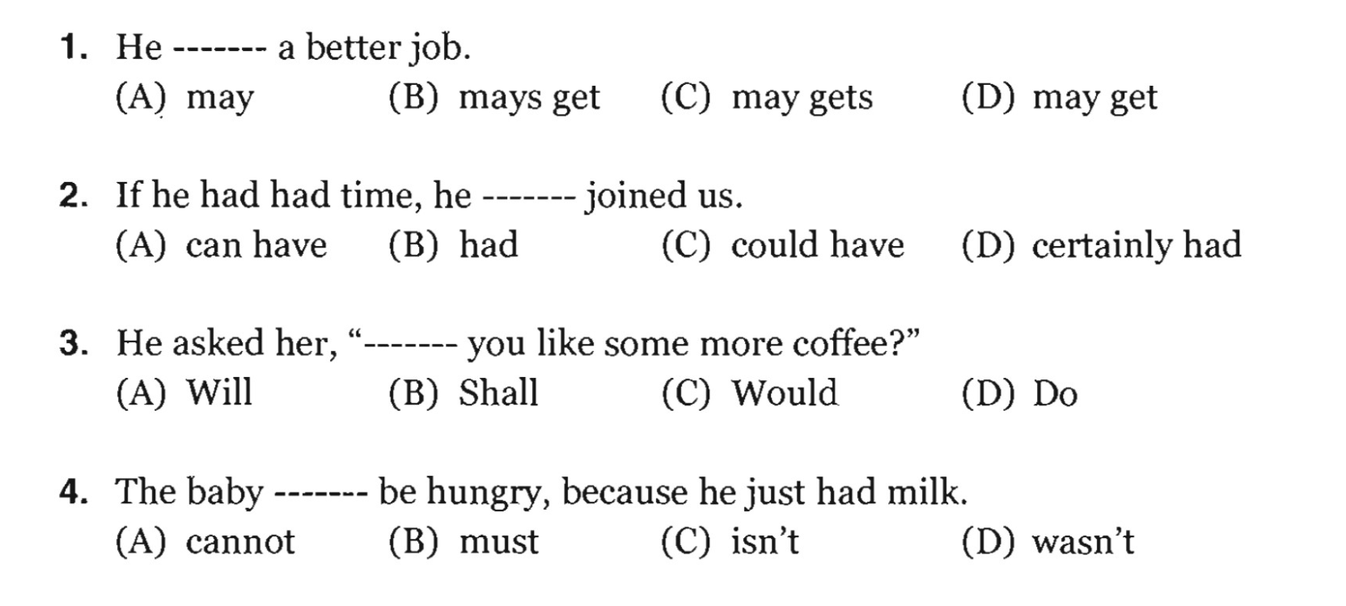
Practice
Choose A, B, C, or D

Slide 12
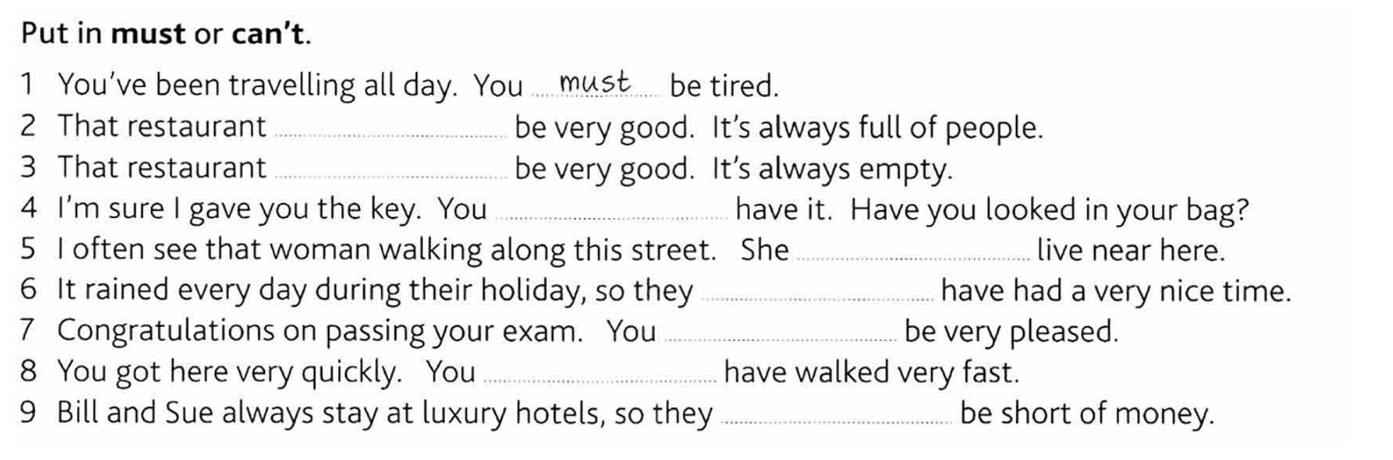
must
can’t
must
must
can’t
must
must
can’t

Slide 13
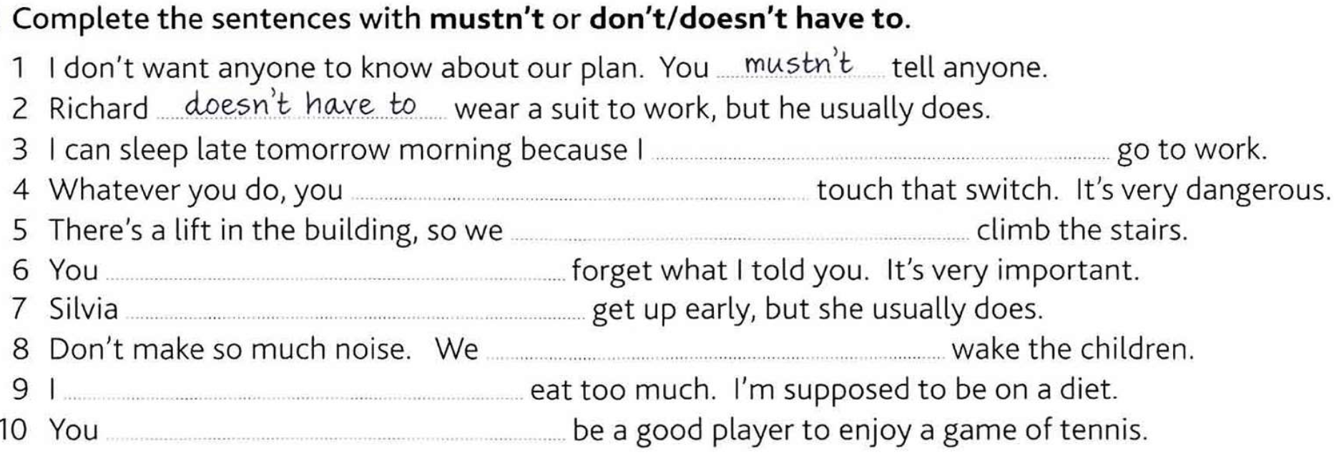
don’t have to
Mustn’t
don’t have to
Mustn’t
doesn’t have to
Mustn’t
Mustn’t
don’t have to

Slide 14
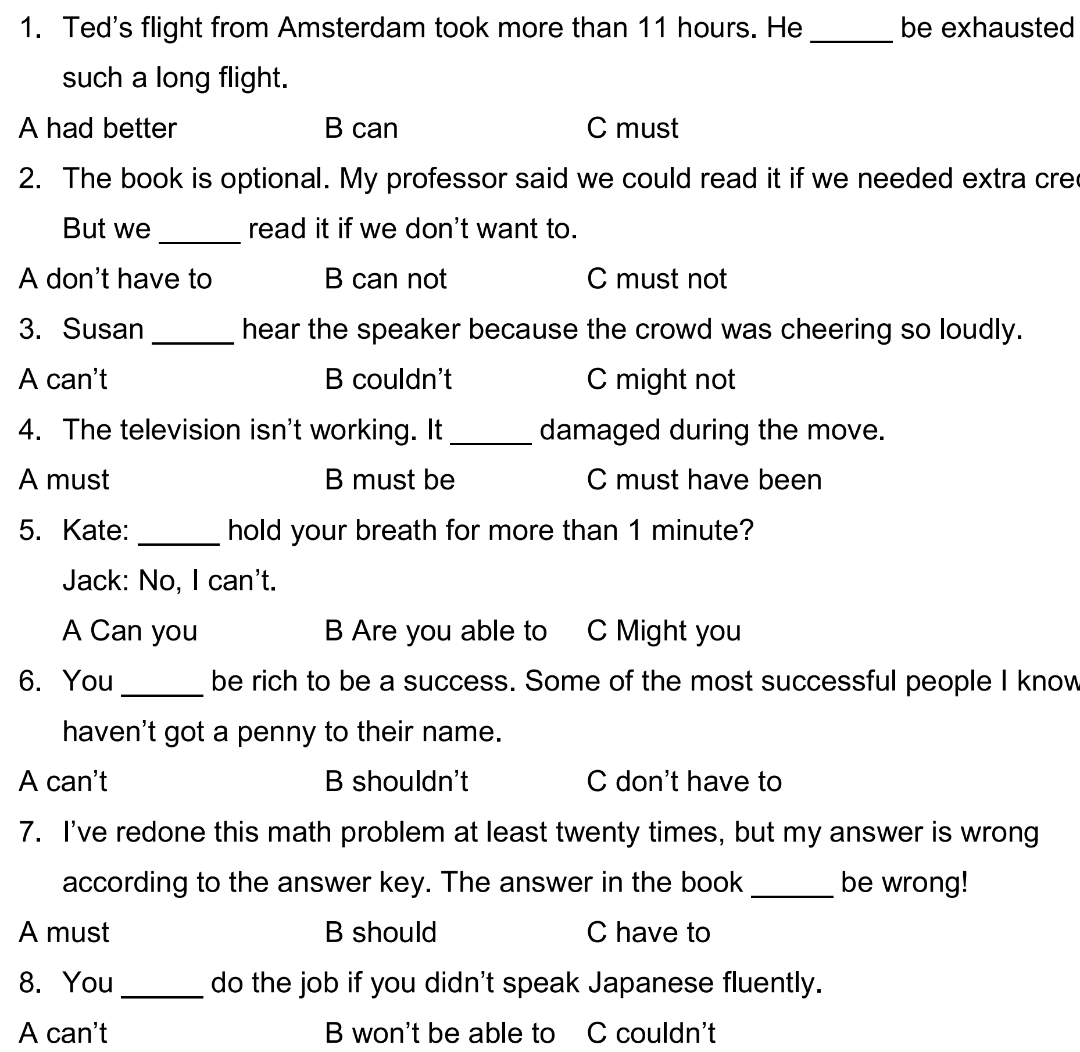

Slide 15
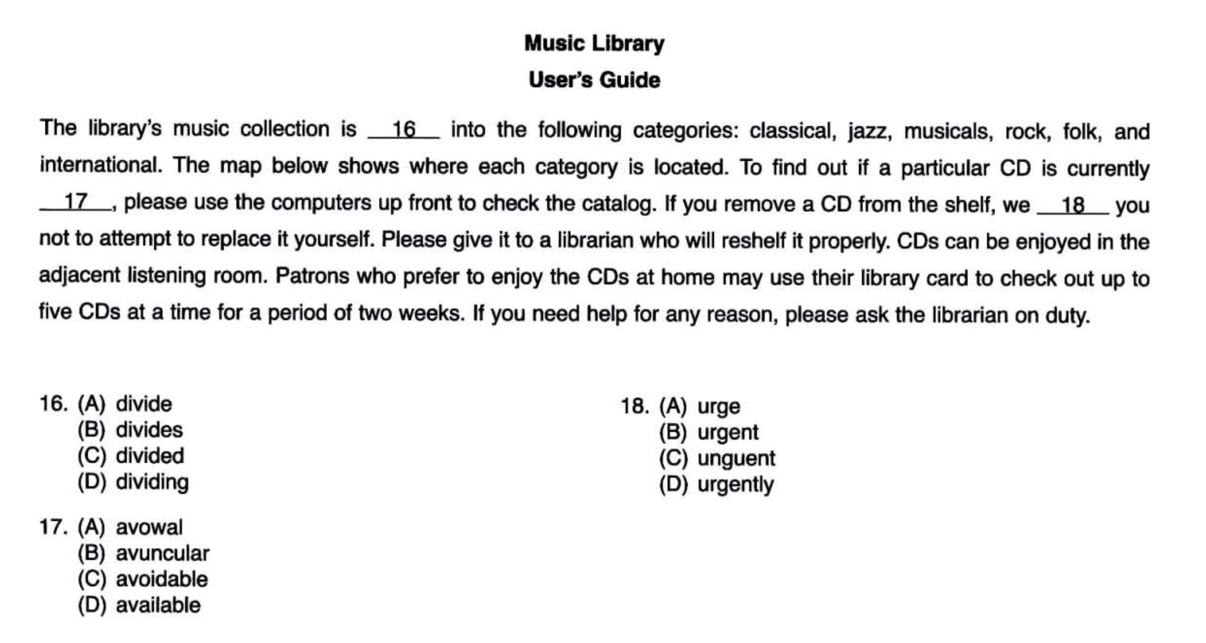

Slide 16
Listening
Short conversations

Slide 17
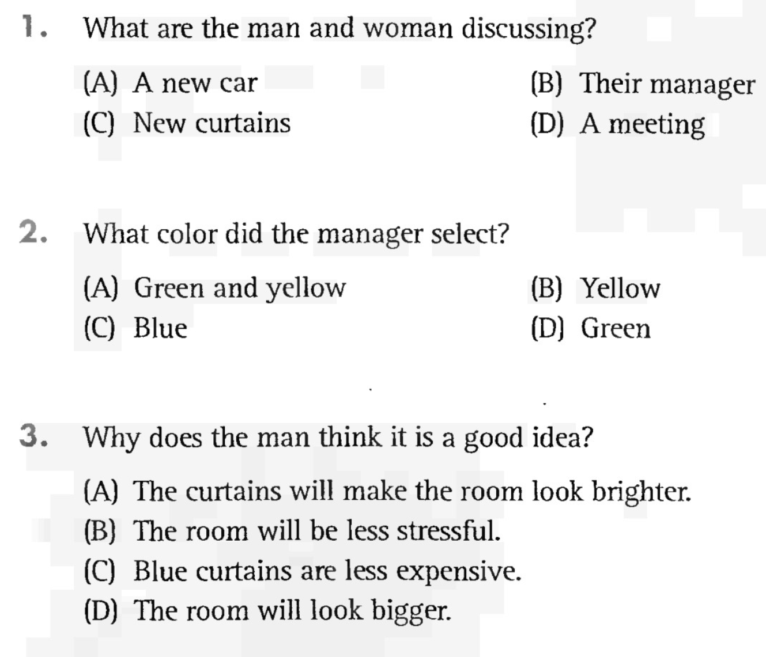
Buy green curtains or yellow curtains
Manager decided to go for green
Reduce stress

Slide 18
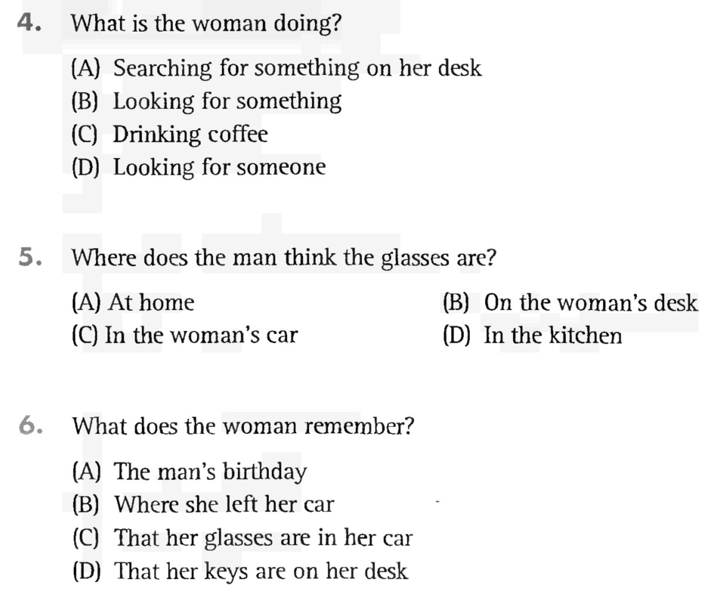
I can’t find my glasses
Probably on your desk
Leaving them in my car

Slide 19
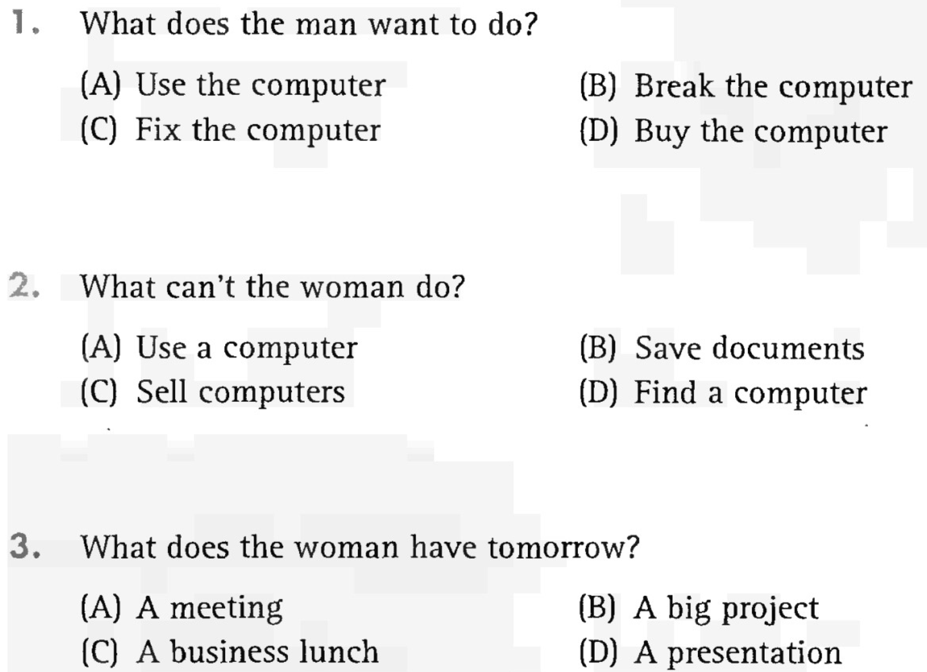
Can I use your computer?
Can’t save documents
Have a presentation

Slide 20
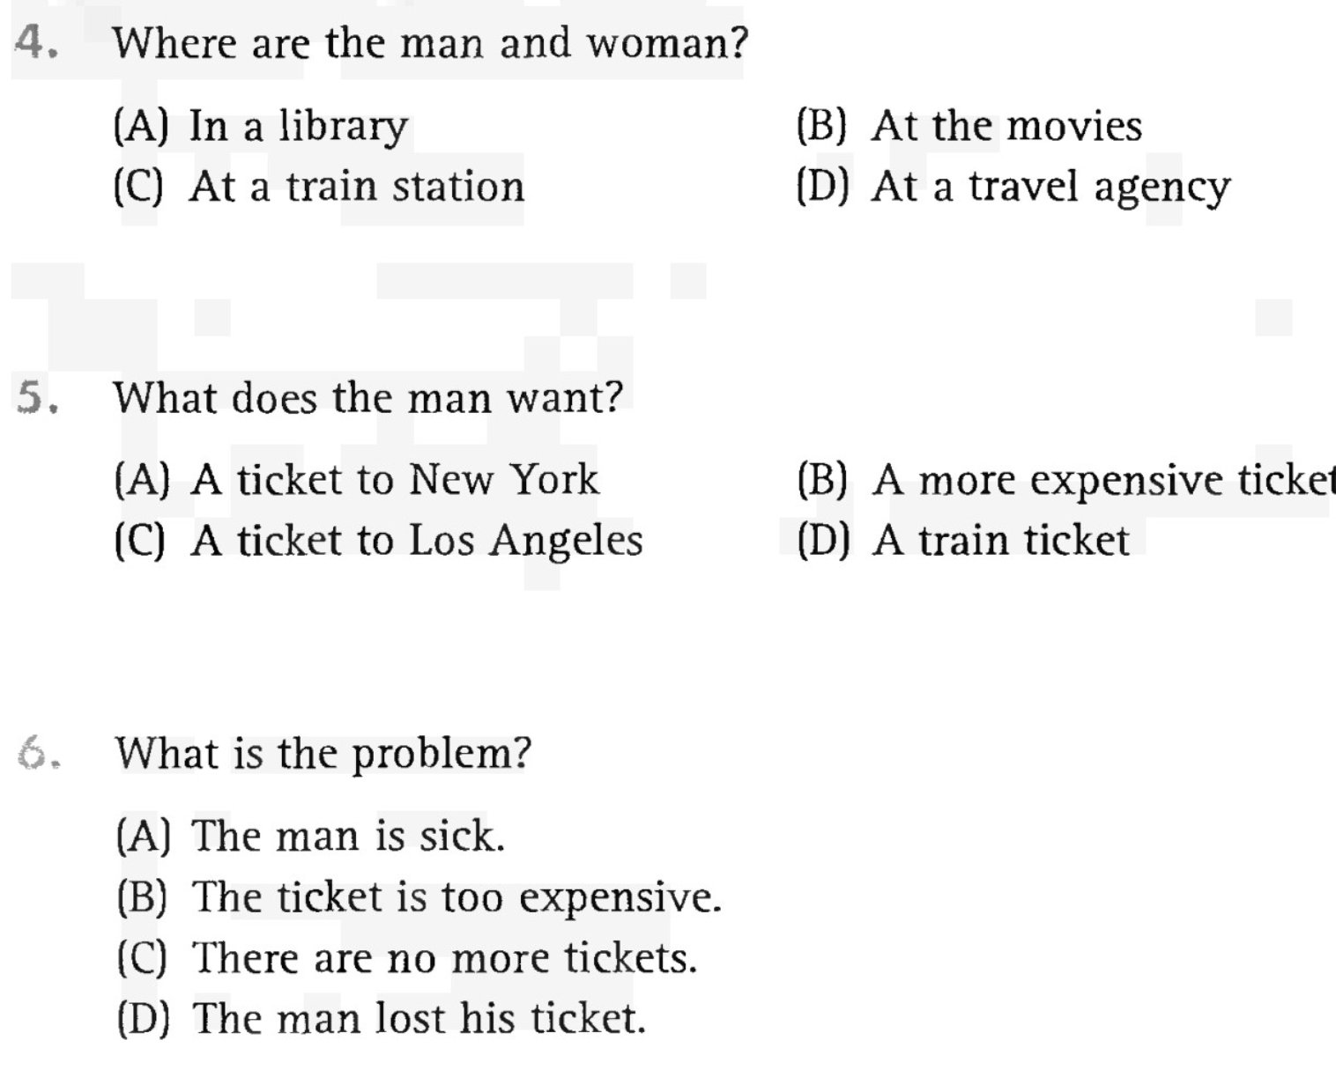
One ticket, express air, airlines
Ticket from Los Angeles to New York
Too expensive, cheaper

Slide 21
3
Vocabulary Hotels

Slide 22
advanced (adj) /ədˈvænst/: highly developed; at a higher level
a. Since the hotel installed an advanced computer system, all operations have been functioning more smoothly.
b. Pablo has been promoted to assistant manager and he is happy with the advanced position.
chain (n) /tʃeɪn/: a group of enterprises under a single control
a. Budget-priced hotel chains have made a huge impact in the industry.
b. The hotel being built in Seoul is the newest one in the chain.
check in (v) /ˈtʃek ɪn/: to register at a hotel; to report one’s presence
a. Patrons check in at the hotel immediately upon their arrival.
b. To know that the conference guests have arrived, we ask them to check in at the registration desk.

Slide 23
confirm (v) /kənˈfɜːrm/: to validate
a. Jorge called the hotel to confirm that he had a room reservation.
b. We automatically send a postcard to let you know that your travel dates have been confirmed.
expect (v) /ɪkˈspekt/: to consider probable or reasonable
a. You can expect a clean room when you check in at a hotel.
b. Mr. Kim expected that the bed linens would be changed daily.
housekeeper (n) /ˈhaʊskiːpər/: someone employed to do domestic work
a. Eloise’s first job at the hotel was a housekeeper and now she is the manager.
b. The desk clerk is sending the housekeeper to bring more towels to your room.

Slide 24
notify (v) /ˈnəʊtɪfaɪ/: to report
a. They notify the hotel that they had been delayed in traffic and would be arriving late.
b. Lydia notified the hotel in writing that she was cancelling her reservation.
preclude (v) /prɪˈkluːd/: to make impossible; to rule out
a. The horrible rainstorm precluded us from travelling any further.
b. The unexpected cost of the room precluded a gourmet dinner for the travelers.
quote (v) /kwəʊt/: to give exact information on; (n) a quotation
a. We were quoted a price of $89 for the room for one night.
b. Call ahead and get a price quote for a week-long stay.

Slide 25
rate (n) /reɪt/: the payment or price according to a standard
a. The rate for the hotel room is too high considering how few services are available on-site.
b. The sign in the lobby lists the seasonal rates.
reservation (n) /ˌrezərˈveɪʃn/: an agreement to set something aside
a. I know I made a reservation for tonight, but the hotel staff has no record of it in the system.
b. It is difficult, if not impossible, to get reservations at this hotel at the height of the summer season.
service (n) /ˈsɜːrvɪs/: useful functions
a. The hotel has a number of luxury services like the on-site gym, sauna, pool and beauty salon.
b. Mr. Rockmont called room service to order a late-night snack.

Slide 26
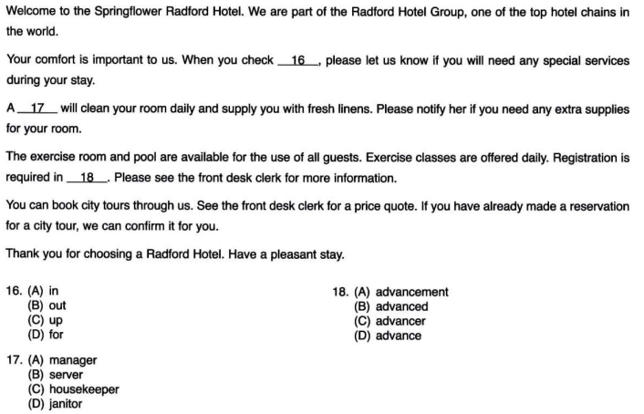
Practice: Text completion:

